Slide 1

Succesion to the
British Throne

Slide 2

Exercise 3. Succession to the British throne

Slide 3

01.
Theory Aspects
02.
Solution
Conclusion

Slide 4
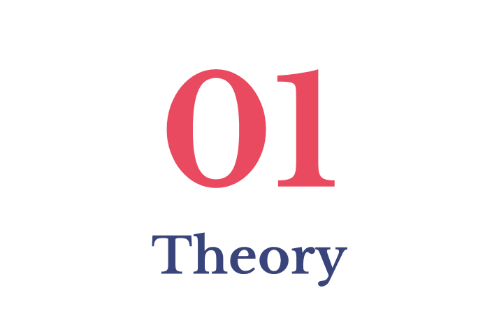

Slide 5
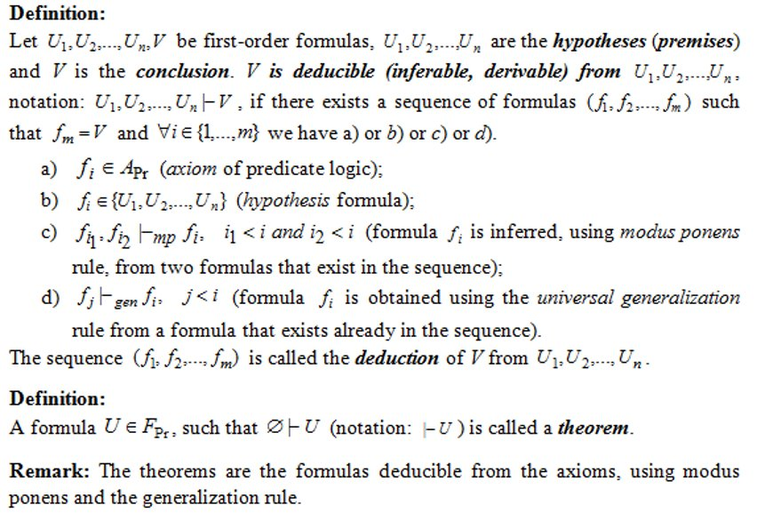
Deduction in First-Order(Predicate) Logic

Slide 6
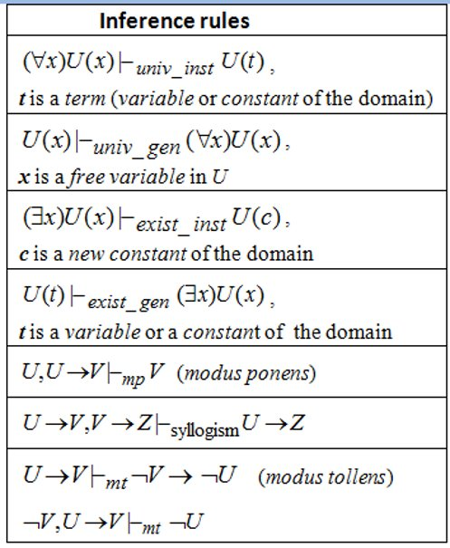
Inference Rules in First-Order(Predicate) Logic

Slide 7
02
Solution

Slide 8
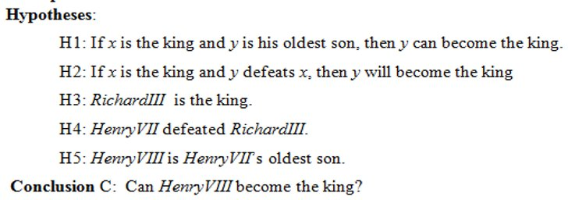
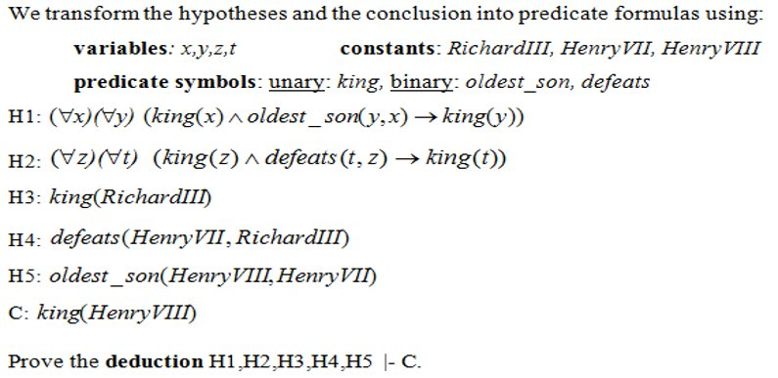
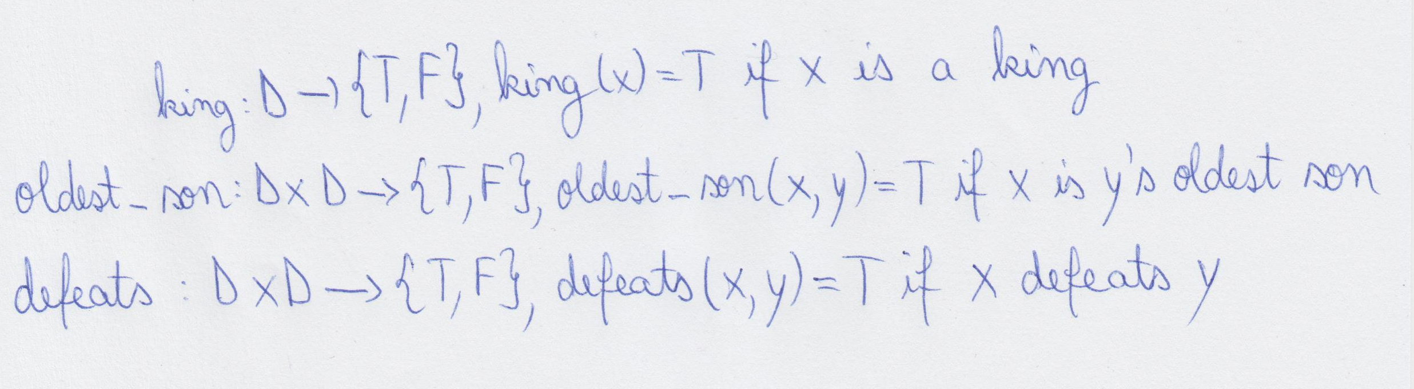
domain: D (the universe of all people)
We define the predicate symbols:

Slide 9
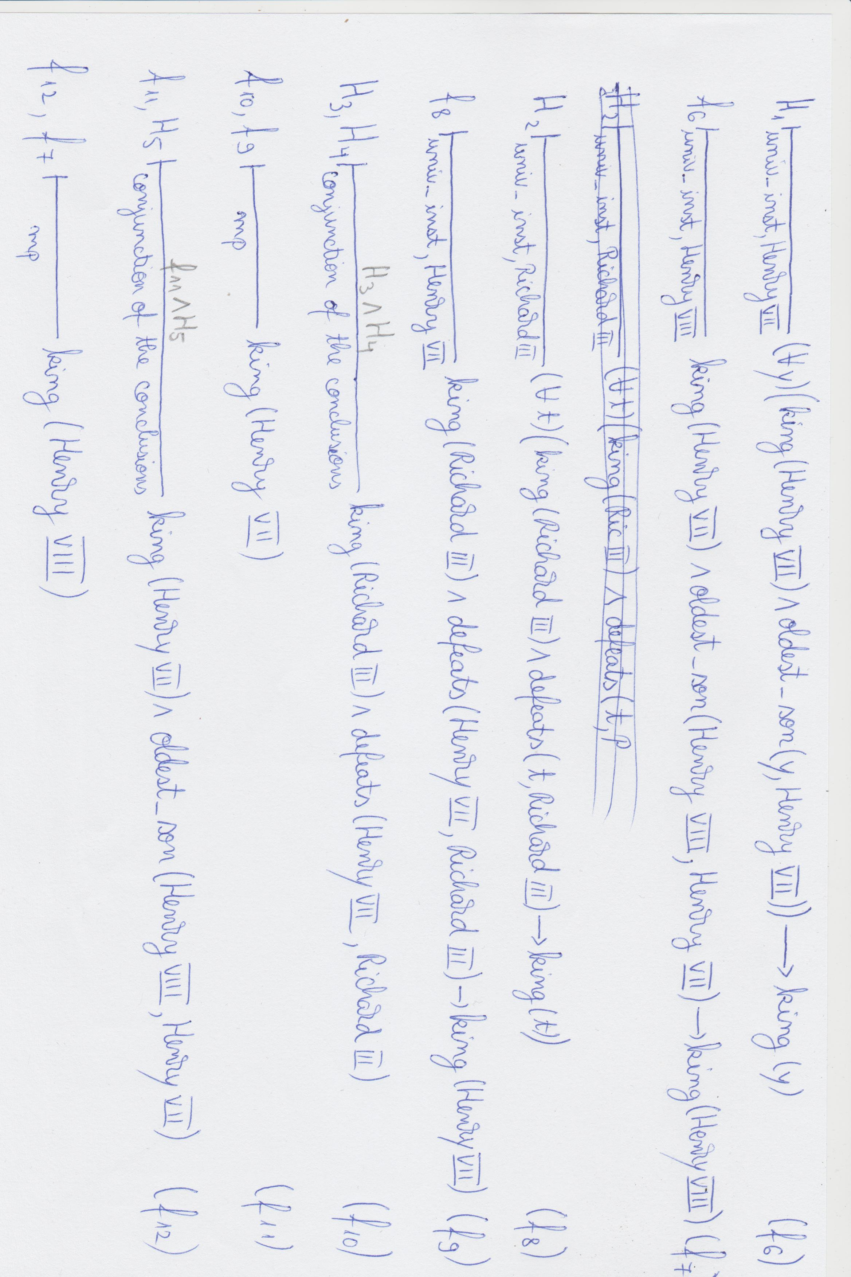
The transformed hypotheses look like this:

Slide 10


Slide 11
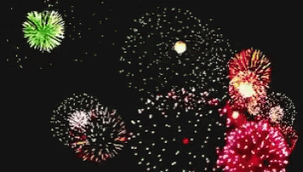
Using the definition of deduction and the appropriate inference rules we proved that the conclusion C is derivable from the set of Hypotheses {H1,H2,H3,H4,H5} and Henry VIII can indeed, become the king.

Slide 12
Thanks for your attention!

